Slide 1
Discrete Mathematics
Spring 2020
Yuan Ze University

Slide 2
Statements with quantifiers

Slide 3
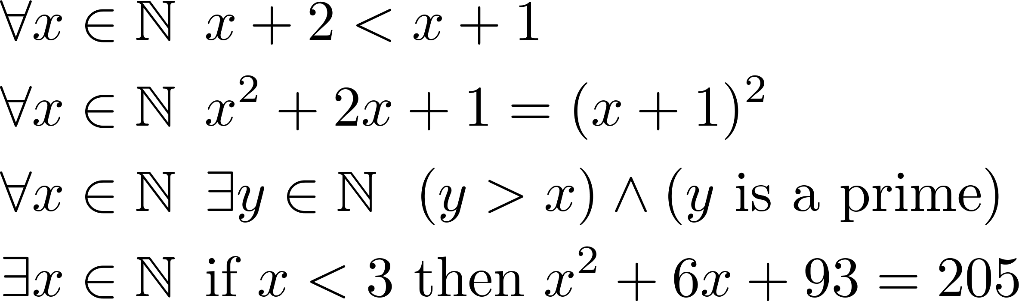
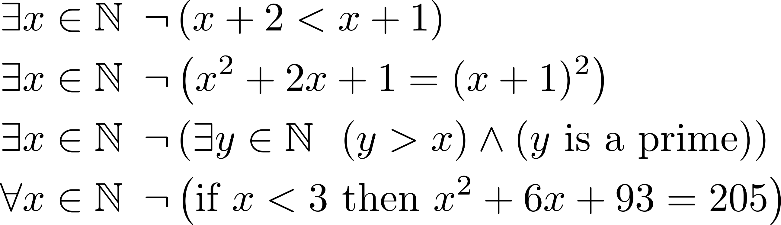
Some statements, true or false
Not

Slide 4





Slide 5
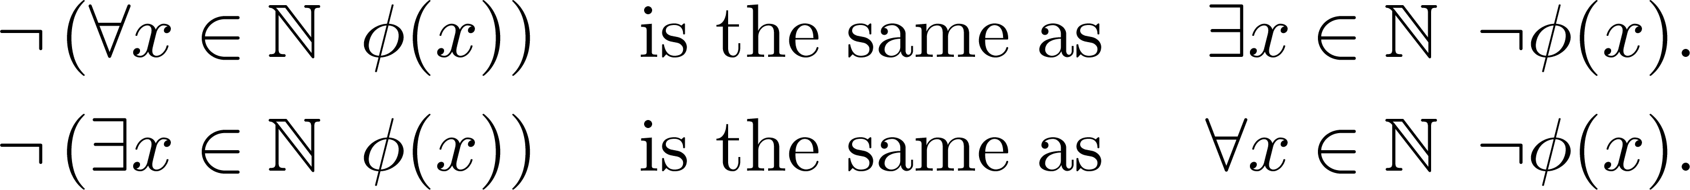
An observation

Slide 6
Example
The negation of “It is sunny everyday” is “There exists a day that is not sunny”

Slide 7
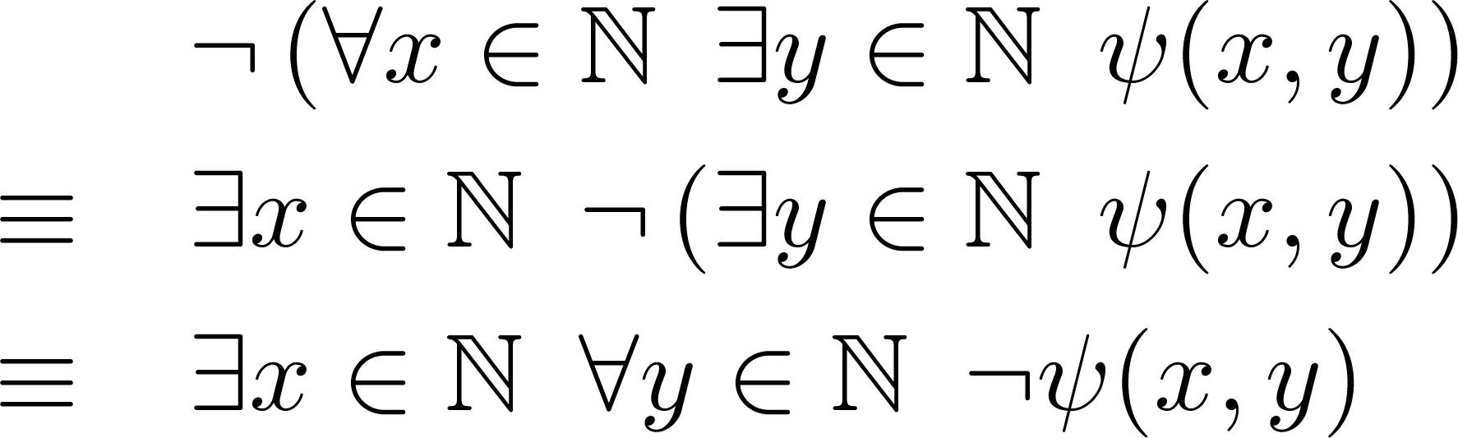
So…
General rules?

Slide 8
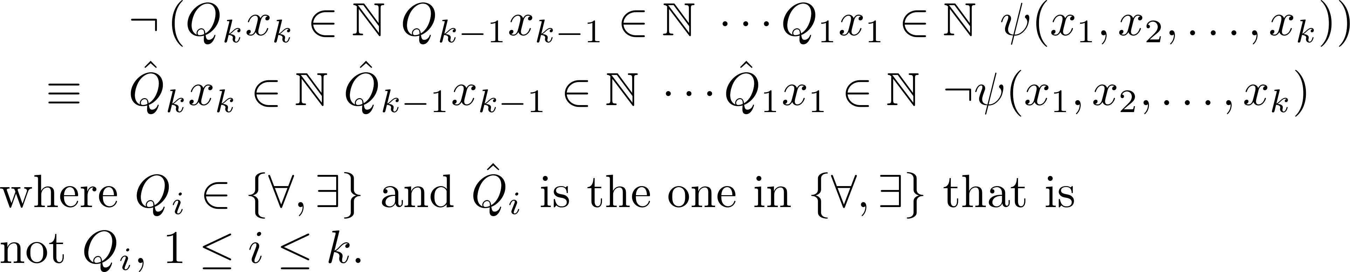
The general rule

Slide 9
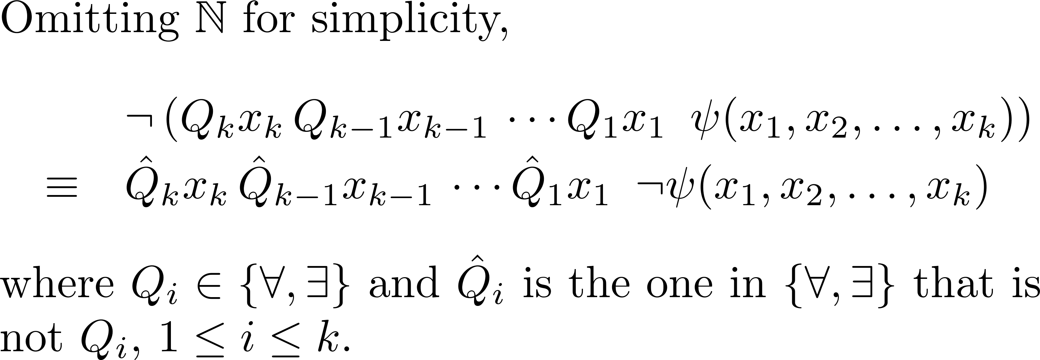

The general rule

Slide 10
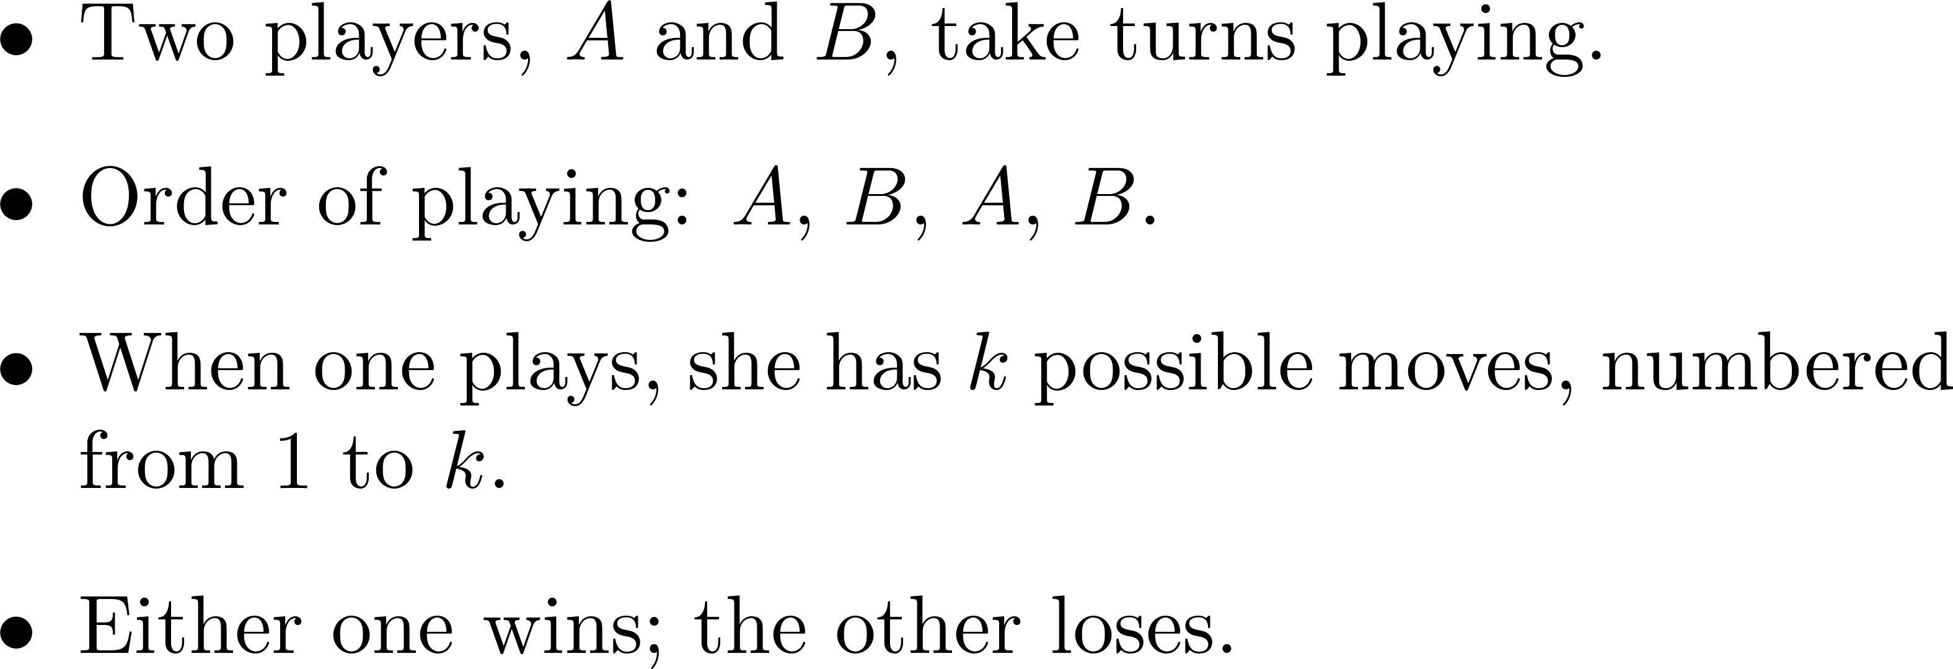
A type of two-person games

Slide 11
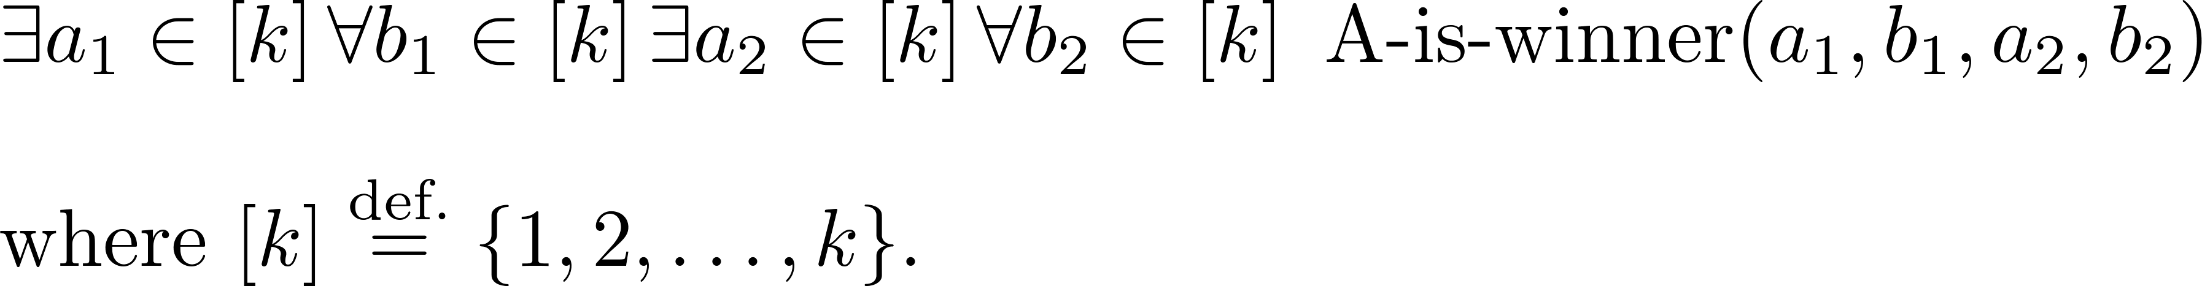
A’s winning strategy

Slide 12
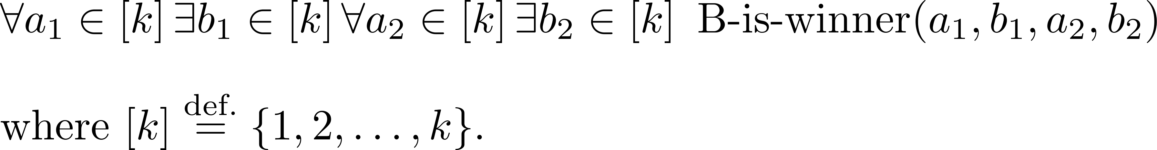
B’s winning strategy

Slide 13
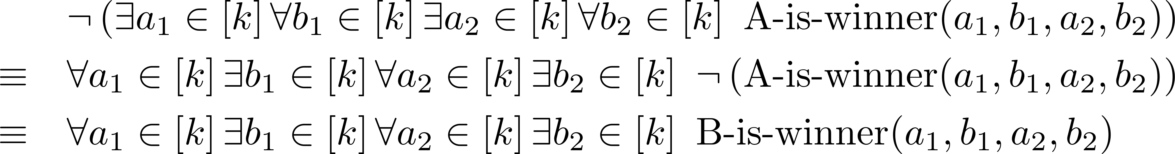
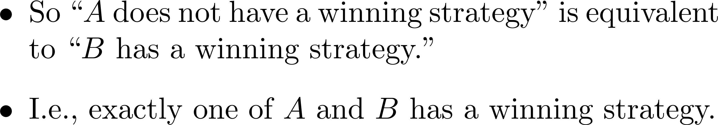
A surprising fact

Slide 14
Relaxations
Is it important that there are four moves in total?

Slide 15
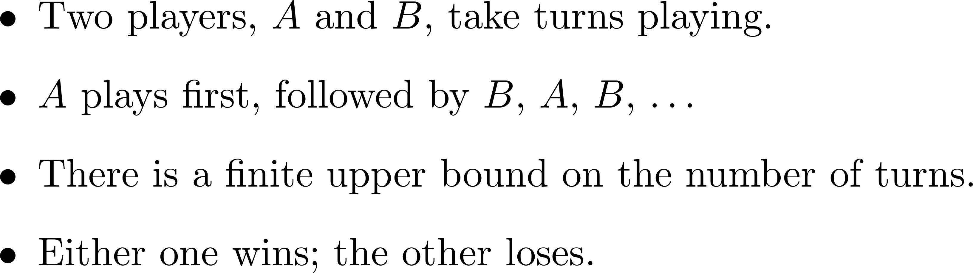
A type of two-person games
Then one of the players has a winning strategy.

Slide 16
For six moves…

Slide 17

A toy example
Initially, both sticks are attached with a finite number of balls.
Two players take turns to choose
a stick and remove a positive
number of balls from it.
The one who empties the sticks
wins.

Slide 18
Other games?
In any two-player, turn-taking, win–lose game with an upper bound on the number of turns, one of the players must have a winning strategy. (Assume that each player sees the other’s moves, that there is a predetermined set of available strategies for each player in each round and that the sequence of moves played determine the outcome.)
Widely applicable!

Slide 19
Specifically for the above game…
The winning strategy is to always leave the two sticks with the same number of balls.
Why?
So, if the sticks are initially unbalanced, then the first player has a winning strategy.
Otherwise the second player does.

Slide 20
A deeper theorem—a glimpse
Can we write a program that, given as input a general statement concerning additions, multiplications and comparisons between natural numbers (like in the following), decides whether it is true?
No, and it is not about programming languages, CPU speeds, parallelization, networking, design of chips, etc.

Slide 21
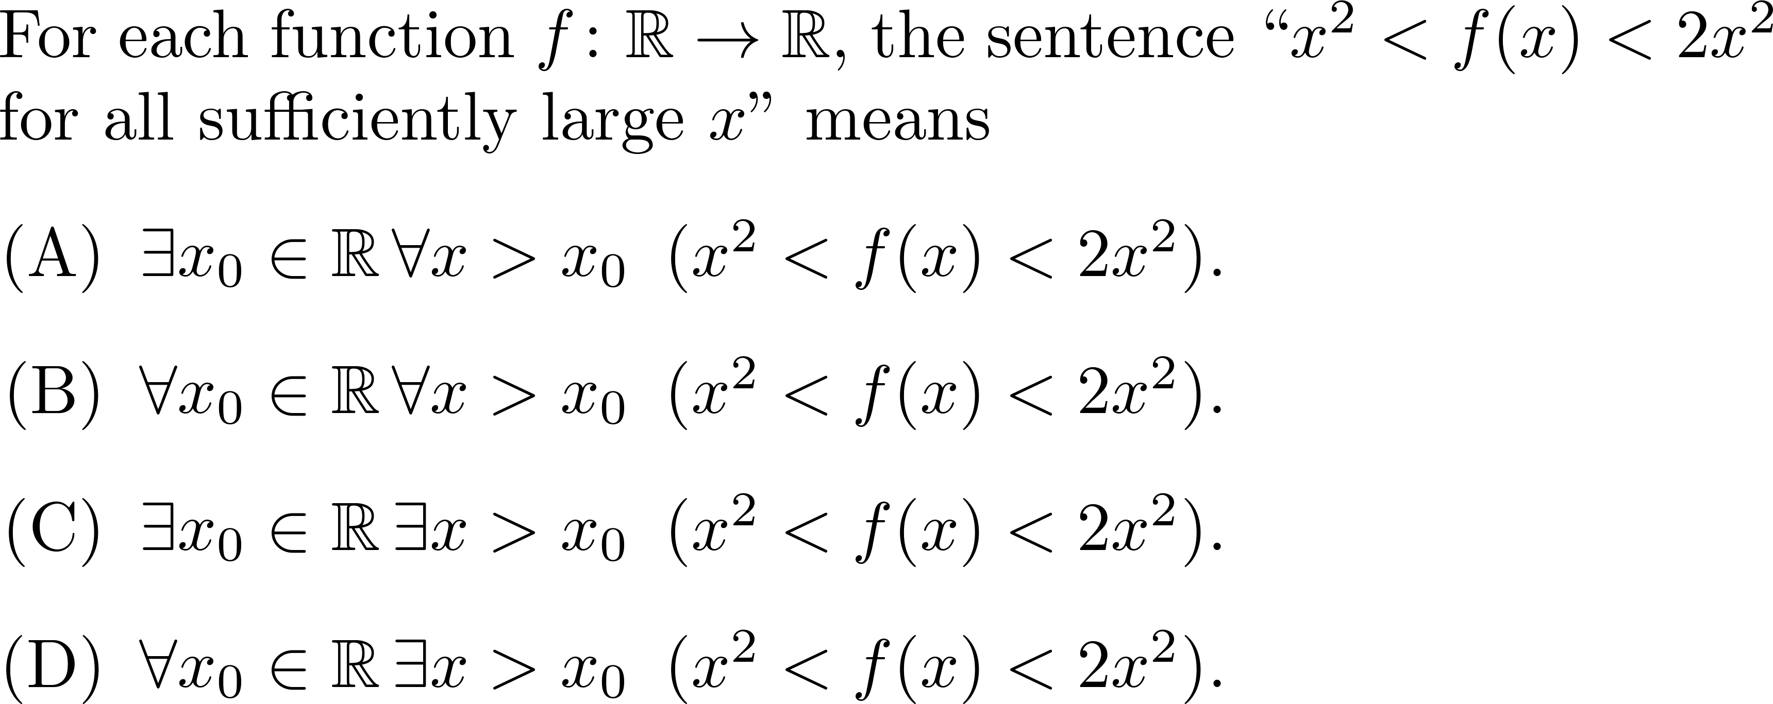
Quiz

Slide 22
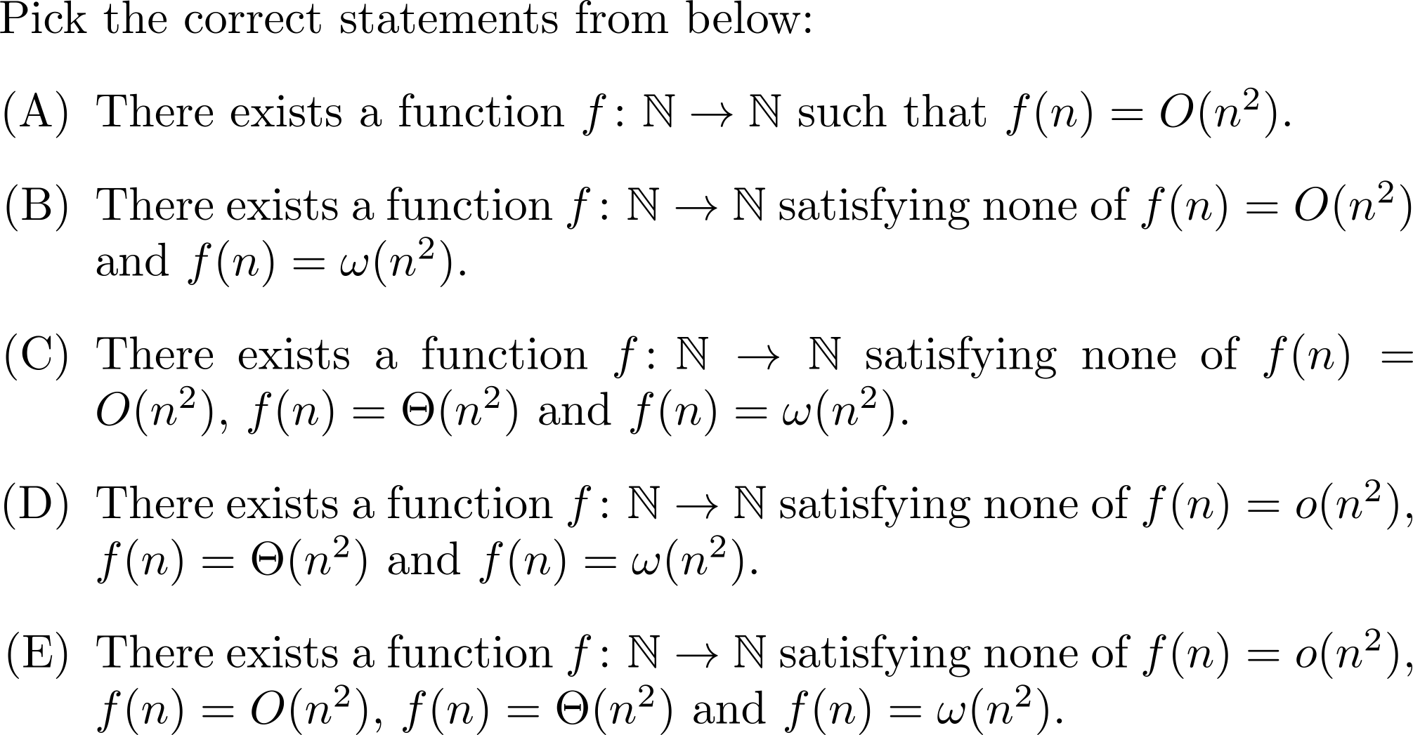
Quiz, please refer to this

Slide 23
Comments?

